Slide 1
JavaFX-Java’s next generation
GUI Framework
Introducing GUI Programming with JavaFX
Copyright © 2013 by The McGraw-Hill Companies, Inc. All rights reserved.

Slide 2
Evolution of Java GUI framework
The original GUI framework was the AWT
Abstract Window Toolkit ( AWT)
Because of its several limitations, it was soon
followed by Swing, which offered a far superior
approach to creating GUIs
Swings are light weight components( Written in Java)
In swings, Look and Feel of components is same across all the platforms

Slide 3
Swing for Enterprise applications
Enterprise applications : primary focus is on simplification and improvement of the business processes.

Slide 4
JavaFX for consumer applications
Consumer applications : especially Mobile apps
demand a GUI that has “visual sparkle.”
The trend is toward more exciting visual effects
which helps to take hold of a diverse audience

Slide 5
JavaFX
provides a powerful, streamlined, flexible framework that simplifies the creation of modern, visually exciting GUIs.
Is JavaFX designed as a replacement for Swing?
The answer is a qualified Yes.
JavaFX is lightweight
support an MVC ( Model View Control ) architecture

Slide 6
The JavaFX Packages
There are more than 30 JavaFX packages in its API library. All begin with the javafx prefix.
Examples
import javafx.application.*;//Application class
import javafx.stage.*; //Stage class
import javafx.scene.*;// Scene class
import javafx.scene.layout.*;// FlowPane, GridPane
import javafx.scene.control.*;// Label,CheckBox etc
import javafx.event.*;//ActionEvent class, //EventListener Generic interface
import javafx.scene.input.MouseEvent;

Slide 7
The JavaFX Packages
import javafx.geometry.*;// Insets, Pos enum
import javafx.scene.text.Font;
import javafx.beans.value.*;
//Interface ChangeListener<T>
import javafx.collections.*;//ObservableList Generic interface
import javafx.scene.shape.*;// Rectangle, Circle
javafx.scene.canvas.*;
javafx.scene.paint.Paint;

Slide 8
javafx.collections package interfaces
Interfaces:
ObservableList: A list that enables listeners to track changes when they occur
ListChangeListener: An interface that receives notifications of changes to an ObservableList
ObservableMap: A map that enables observers to track changes when they occur
MapChangeListener: An interface that receives notifications of changes to an ObservableMap

Slide 9
javafx.collections package classes
FXCollections: A utility class that consists of static methods that are one-to-one copies of java.util.Collections methods
ListChangeListener.Change: Represents a change made to an ObservableList
MapChangeListener.Change: Represents a change made to an ObservableMap

Slide 10
The Stage and Scene Classes
Stage is a top-level container
stage is a container for scenes.
All JavaFX applications have at least one stage and one scene
All JavaFX applications automatically have access to one Stage, called the primary stage. The primary stage is supplied by the run-time
system when a JavaFX application is started.

Slide 11
Scene Class
Scene is a container for the items that comprise the scene. These can consist of controls, such as push buttons and check boxes, text, and graphics.
To create a scene, you will add those elements to an instance of Scene.

Slide 12
Nodes and Scene Graphs
The individual elements of a scene are called nodes.
For example, a push button control is a node. However, nodes can also consist of groups of nodes.
A node can have a child node. a node with a child is called a parent node or branch node. Nodes without children are terminal nodes and are called leaves.

Slide 13
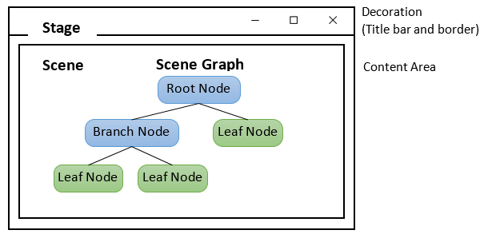
Scene Graph
collection of nodes makes a scene graph.
All these nodes are arranged in a hierarchical order as shown below

Slide 14
Scene constructor
FlowPane rootNode = new FlowPane();
Scene(Parent rootnode, double width, double height)
// Create a scene.
Scene myScene = new Scene(rootNode, 300, 200);
Notice that the type of rootnode is Parent. It is a subclass of Node and encapsulates nodes that can have children.

Slide 15
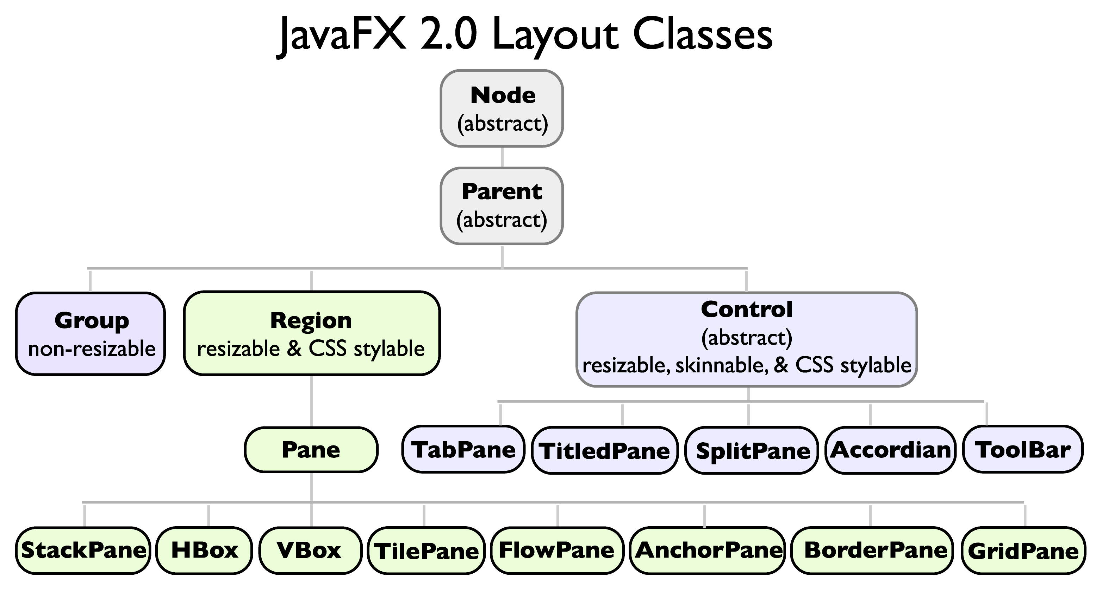

Slide 16
The collection of all nodes in a scene creates what is referred to as a scene graph, which comprises a tree.
There is one special type of node in the scene graph, called the root node.
This is the top-level node and is the only node in the scene graph that does not have a parent.
all other nodes have parents, and all nodes either directly or indirectly descend from the root node.

Slide 17
Node class
The base class for all nodes is Node.
There are several other classes that are, either directly or indirectly, subclasses of Node. These include Parent, Group, Region, and Control, to name a few.

Slide 18
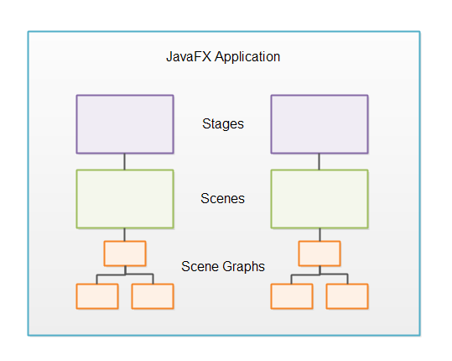

Slide 19
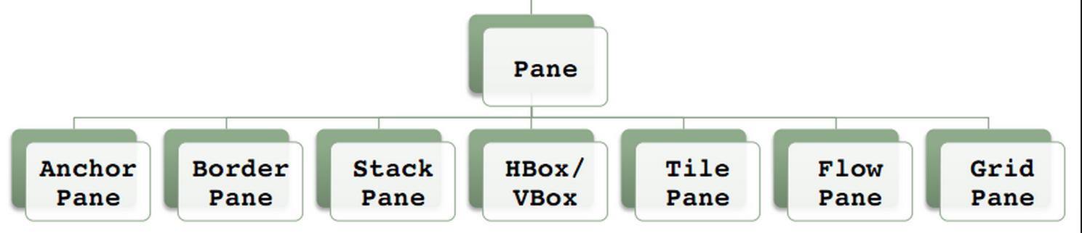
Layouts

Slide 20
Layouts
JavaFX provides several layout panes that manage the process of placing elements in a scene.
FlowPane class provides a flow layout
GridPane class supports a row/column grid-based layout.
BorderPane (which is similar to the AWT’s BorderLayout)
The layout panes are packaged in
javafx.scene.layout.

Slide 21
The Application Class and the Life-cycle Methods
A JavaFX application must be a subclass of the Application class, which is packaged in javafx.application
The Application class defines three life-cycle methods that your application can override. These are called init( ), start( ), and stop( ), and are shown here, in the order in which they are called:
void init( )
abstract void start(Stage primaryStage)
void stop( )

Slide 22
init() method of Application class
The init( ) method is called when the application begins execution
Used to perform various initializations
Cannot be used to create a stage or build a scene.
If no initializations are required, this method need not be overridden because an empty, default version is provided.

Slide 23
You also cannot create stage or build a scene
inside the application’s constructor.
The reason is that a stage or scene must be constructed on the application thread.
However, the application’s constructor and the init( ) method are called on the main thread, also called the launcher thread.
start( ) is called on the application thread.
The stop( ) method is also called on the application thread.

Slide 24
Start() method of Application class
The start( ) method is called after init( ).
This is where your application begins and it can be used to construct and set the scene. Notice that it is passed as a reference to a Stage object. This is the stage provided by the run-time system and is the primary stage
Is abstract, so must be overridden by your
application

Slide 25
stop() method of Application class
When your application is terminated, the stop( ) method is called.
Used to handle any cleanup or shutdown chores.
In cases in which no such actions are needed, an empty, default version is provided.

Slide 26
Launching a JavaFX Application
To start a free-standing JavaFX application, you must call the launch( ) method defined by Application. It has two forms. Here is the one used in this chapter:
public static void launch(String … args)
When called, launch( ) causes the application to be constructed, followed by calls to init( ) and start( ). The launch( ) method will not return until after the application has terminated.

Slide 27
A JavaFX Application Skeleton
// A JavaFX application skeleton.
import javafx.application.*;
import javafx.scene.*;
import javafx.stage.*;
import javafx.scene.layout.*;
import javafx.scene.control.Label;

Slide 28
public class JavaFXSkel extends Application
{
public static void main(String[] args)
{
System.out.println("Launching JavaFX Appln.");
// Start the JavaFX application by calling launch().
launch(args);
}

Slide 29
// Override the init() method.
public void init()
{ System.out.println("Inside the init() method.");
}
// Override the stop() method.
public void stop()
{ System.out.println("Inside the stop() method.");
}

Slide 30
// Override the start() method.
public void start(Stage myStage)
{ System.out.println("Inside the start() method.");
// Give the stage a title.
myStage.setTitle("JavaFX Skeleton.");
// Create a root node. In this case, a flow layout is
//used, but several alternatives exist.
FlowPane rootNode = new FlowPane();
// Create a scene.
Scene myScene = new Scene(rootNode, 300, 200);
// Set the scene on the stage.
myStage.setScene(myScene);

Slide 31
// Create a label.
Label myLabel = new Label("JavaFX is a powerful
GUI");
// Add the label to the scene graph.
rootNode.getChildren().add(myLabel);
//Retrieving the observable list object
ObservableList <Node>list = rootNode.getChildren();
//Setting the some Node object as a node
list.add(NodeObject);
// Show the stage and its scene.
myStage.show();
} // start() ends
}// class ends

Slide 32
ObservableList interface
javafx.collections
public interface ObservableList<E>
extends List<E>, Observable

Slide 33
Output
Launching JavaFX application.
Inside the init() method.
Inside the start()
When you close the window, this message is displayed on the console:
Inside the stop() method.

Slide 34
JavaFX Controls
Label
TextField
PasswordField
Button
CheckBox
RadioButton
ToggleButton
ListView

Slide 35
Adding controls to the Scene graph
First call getChildren( ) on the root node of the scene graph.
It returns a list of the child nodes in the form of an ObservableList<Node>.
ObservableList is packaged in javafx.collections, and it inherits java.util.List, which means that it supports all of the features available to a list as defined by the Collections Framework.
Using the returned list of child nodes, you can add the label to the list by calling add( ).

Slide 36
root Node will be a javafx.scene.layout.Pane or one of its subclasses

Slide 37
Label Control
javafx.scene.control.Label
The simplest control is the label because it just
displays a message(text)
Label( ), setText(String), String getText()
Label(String str), Label(String str, Node image)
image type will be ImageView.
E.g. Label myLabel=new Label(“Text”);
Adding/removing it to the scene graph
rootNode.getChildren().add(myLabel);
rootNode.getChildren().remove(myLabel);

Slide 38
Label with Text and an image
Label lbl=new Label(“Some String”, new ImageView(“image.png”));
Add an image to a label after it has been constructed by using the setGraphic( ) method.
final void setGraphic(Node image)
Here, image specifies the image to add.
Label lbl=new Label(“Some String”) ;
lbl.setGraphic(new ImageView(“image.png”));

Slide 39
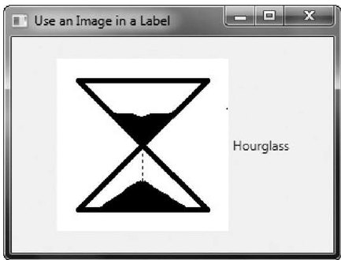
Import javafx.scene.image.*;

Slide 40
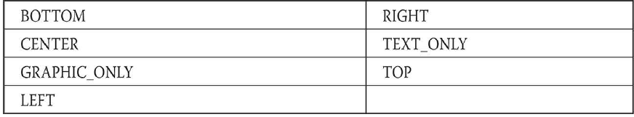
Both image and the text are displayed. By default the text is to the right of the image. You can change the relative positions of the image and text by calling setContentDisplay( ) on the label
final void setContentDisplay(ContentDisplay position)
The value passed to position determines how the text and image are displayed. It must be one of these values, which are defined by the ContentDisplay enumeration:

Slide 41
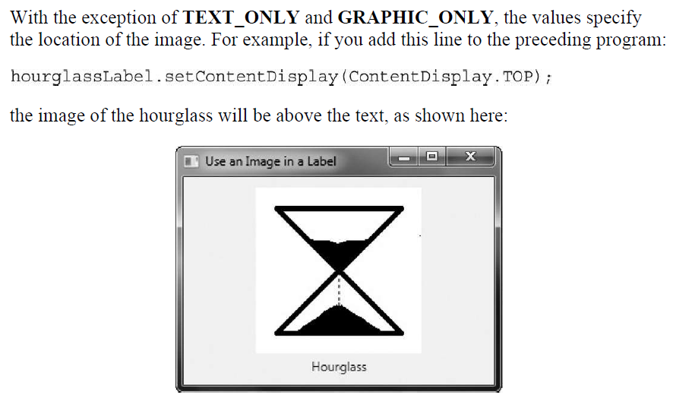

Slide 42
TextField
It allows one line of text to be entered. Thus, it is useful for obtaining names, ID strings, addresses.
Like all JavaFX text controls, TextField inherits TextInputControl,
Constructors: TextField(), TextField(String)
setText( ), getText()
final void setPrefColumnCount(int columns)
To set a prompting message inside the text field
final void setPromptText(String str)

Slide 43
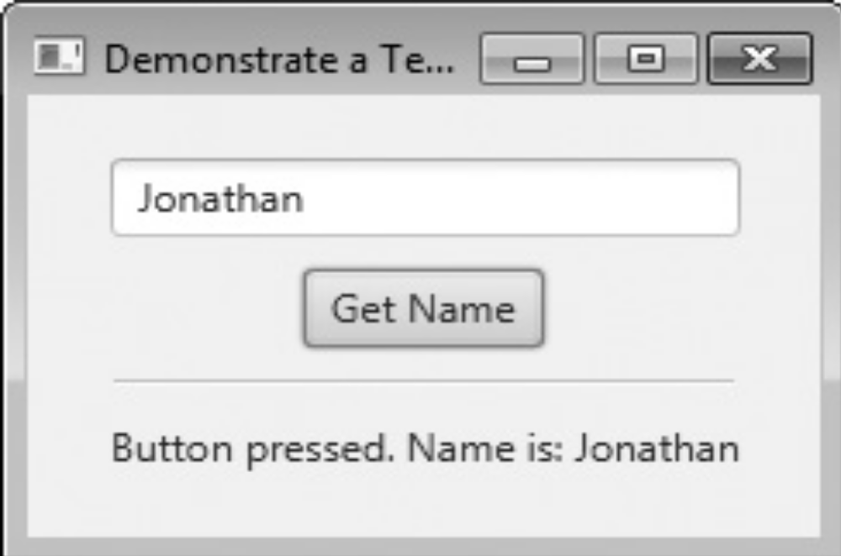

Slide 44
Event Handling with TextField
When the user presses enter while inside a TextField, an action event is generated.
Label response = new Label("Enter Name: ");
TextField tf= new TextField();
// Set the prompt.
tf.setPromptText("Enter a name.");
// Set preferred column count. tf.setPrefColumnCount(15);

Slide 45
Event Handling with TextField using anonymous inner classes
tf.setOnAction(new EventHandler<ActionEvent>(){
public void handle(ActionEvent ae){
response.setText("Enter pressed. Name is: " +tf.getText());
}});
javafx.event package has an
Interface EventHandler<T extends Event>
One abstract method: public void handle(T e)

Slide 46
What other text controls does JavaFX support?
TextArea, which supports multiline text
PasswordField, which can be used to input passwords

Slide 47
Button
javafx.scene.control. Button inherits a fairly long list of base classes that include
ButtonBase, Labeled, Region, Control, Parent, and Node.
Buttons can contain text, graphics, or both
Constructor: Button(String str)
Button(String str, Node image)
Button b=new Button(“Reset”, new ImageView(“image.jpg”);

Slide 48
You can also add an image to a label after it has been constructed by using the setGraphic( ) method. It is shown here:
final void setGraphic(Node image)
Here, image specifies the image to add.

Slide 49
Button with only image
If you want a button that contains only the image, pass a null string for the text when constructing the button and then call
btn.setContentDisplay(ContentDisplay.GRAPHIC_ONLY)

Slide 50
Event handling with Button
When a button is pressed, an ActionEvent is generated.
ActionEvent is packaged in javafx.event.
You can register a listener for this event by using setOnAction( ) which has this general form:
final void setOnAction(EventHandler<ActionEvent> handler)

Slide 51
EventHandler<T extends Node> interface
ActionEvent is packaged in javafx.event.
You can register a listener for this event by using setOnAction( ),
which has this general form:
final void setOnAction(EventHandler<ActionEvent> handler)

Slide 52
CheckBox control
CheckBox is a box with a tick on it when selected and empty when not selected
A subclass of ButtonBase.
CheckBox(String str)
CheckBox supports three states
    Checked: When indeterminate is false and checked is true
    Unchecked: When indeterminate is false and checked is false
    Undefined(indeterminate) :When indeterminate is true
    Undefined state is typically used to indicate that the state of the check box has not been set or that it is not relevant to a specific situation.

Slide 53
by default, CheckBox implements two states: checked and unchecked.If you want to add the indeterminate state, it must be explicitly enabled.
To enable the indeterminate state in a check box
final void setAllowIndeterminate(boolean enable)
To determine if a check box is in the indeterminate state,
final boolean isIndeterminate( )
CheckBox generates an action event when it is selected.
Use isSelected( ) to determine the state of the check boxes

Slide 54
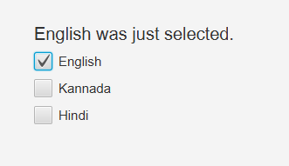

Slide 55
CheckBox example
Label response=new Label(“ ”);
CheckBox cbKan=new CheckBox(“Kannada);
CheckBox cbEng=new CheckBox(“English”);
CheckBox cbHin=CheckBox(“Hindi”);
GridPane root=new GridPane();
root.add(response,0,5);// control, col,row
root.add(cbEng,0,7);
root.add(cbKan,0,9);
root.add(cbHin,0,11);

Slide 56
cbEng.setOnAction(new EventHandler<ActionEvent>() {
public void handle(ActionEvent ae) {
if(cbEng.isSelected())
response.setText(“English was just selected.");
else
response.setText(“English was just cleared.");
}
});

Slide 57
cbEng.setOnAction(new EventHandler<ActionEvent>() { public void handle(ActionEvent ae) { if(cbEng.isIndeterminate())
response.setText(“English checkbox state is indeterminate.");
else if(cbEng.isSelected())
response.setText(“English was just selected.");
else
response.setText(“English was just cleared.");
} });

Slide 58
ToggleButton
A useful variation on the push button is called the toggle button
Like Button, ToggleButton is also derived from ButtonBase.
It implements the Toggle interface, which defines functionality common to all types
of two-state buttons.
ToggleButton(String str)
Here, str is the text displayed in the button.

Slide 59
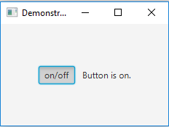
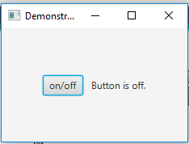

Slide 60
Like other buttons, a ToggleButton generates an action event when it is pressed.
final boolean isSelected( )
It returns true if the button is pressed and false otherwise.

Slide 61
Handle Action events for ToggleButton
ToggleButton togb=new ToggleButton(“on/off”);
Label response=new Label(“ “);
rootNode.getChildren().addAll(togb,response);
togb.setOnAction(new EventHandler<ActionEvent>() {
public void handle(ActionEvent ae) {
if (togb.isSelected())
response.setText(“Button is on.");
else
response.setText(“Button is off.");
} });

Slide 62
RadioButton
RadioButtons are mainly used to create a series of items where only one can be selected.
Constructors of the RadioButton class:
RadioButton():Creates a radio button with an empty string for its label.
RadioButton(String t):Creates a radio button with the specified text as its label
By default, the first RadioButton will have the focus.

Slide 63
Methods of RadioButton class
METHOD | EXPLANANTION
String getText(); | returns the textLabel for radio button
bolean isSelected(); | Reading Selected State returns whether the radiobutton is selected or not
setSelected(boolean b) | sets whether the radiobutton is already selected or not
setToggleGroup(ToggleGroup tg) | sets the toggle group for the radio button
public void fire() | Toggles the state of the radio button if and only if the RadioButton is not already selected or is not part of a ToggleGroup.

Slide 64
To get the current selection for the toggle group
final Toggle getSelectedToggle( )
RadioButton selectedRadioButton = (RadioButton) toggleGroup.getSelectedToggle();
If no RadioButton is selected the getSelectedToggle() method returns null .

Slide 65
Event handling with RadioButton
When a Radio button is pressed and released, an Action event is sent, this Action Event can be handled using an Event Handler.

Slide 66
RadioButton
// create radiobuttons
RadioButton r1 = new RadioButton("male");
RadioButton r2 = new RadioButton("female");
RadioButton r3 = new RadioButton("others");
// create a toggle group
ToggleGroup tg = new ToggleGroup();

Slide 67
// add radiobuttons to toggle group
r1.setToggleGroup(tg);
r2.setToggleGroup(tg);
r3.setToggleGroup(tg);
// add label
r.getChildren().add(l);
r.getChildren().add(r1);
r.getChildren().add(r2);
r.getChildren().add(r3);
r.getChildren().add(l2);

Slide 68
Handling Change Events in a Toggle Group
To determine which radio button has been selected, register a ChangeListener on the
toggle group. When a change event occurs, you
can then determine which button was selected.
javafx.beans.value
Interface ChangeListener<T>
void changed(ObservableValue<? extends T> observable, T oldValue, T newValue)

Slide 69
Toggle Interface
javafx.scene.control package has Interface Toggle
All Known Implementing Classes:
RadioButton, RadioMenuItem, ToggleButton

Slide 70
// add a change listener
tg.selectedToggleProperty().addListener(new ChangeListener<Toggle>()
{
public void changed(ObservableValue<? extends
Toggle> ob, Toggle o, Toggle n)
{
RadioButton rb =
(RadioButton)tg.getSelectedToggle();
if (rb != null) {
// change the label
l2.setText(rb.getText() + " selected");
}
}
});

Slide 71
ListView
Displays a list of entries from which you can select one or more
scrollbars are automatically added when the number of items in the list exceeds the number that can be displayed within the control’s dimensions
Popular because of its ability to make efficient use of limited screen space
class ListView<T> is a Generic class
ListView(ObservableList<T> list) a constructor
ListView()

Slide 72
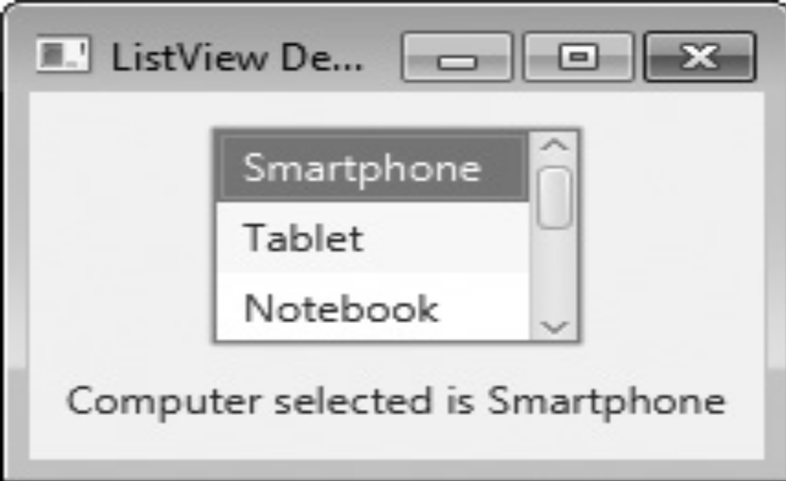
ListView

Slide 73
ListView
Use observableArrayList( ) method, which is a static method of javafx.collections.FXCollections class to create a list of strings.
static <E> ObservableList<E> observableArrayList(E ... elements);
ObservableList<String> computerTypes = FXCollections.observableArrayList("Smartphone", "Tablet", "Notebook", "Desktop" );
ListView<String> lvComputers = new ListView<String>(computerTypes);

Slide 74
Set the preferred height and width
void setPrefSize(double width, double height) ;
lvComputers.setPrefSize(100, 70);
final void setPrefHeight(double height) ;
final void setPrefWidth(double width) ;

Slide 75
The two basic ways to use a ListView
First, you can ignore events generated by the list and simply obtain the selection in the list when your program needs it.
Second, you can monitor the list for changes by registering a change listener. This lets you respond each time the user changes a selection in the list.

Slide 76
Steps to listen for change events
obtain the selection model used by the ListView.
This is done by calling getSelectionModel( ) on the list.
final MultipleSelectionModel<T> getSelectionModel( )
MultipleSelectionModel<String> lvSelModel = lvComputers.getSelectionModel();
MulitpleSelectionModel is a class that defines the model used for multiple selections, and it inherits SelectionModel.
javafx.scene.control.MultipleSelectionModel<T> class

Slide 77
Steps to listen for change events
2) obtain a reference to the selected item property that defines what takes place when an element in the list is selected.
final ReadOnlyObjectProperty<T> selectedItemProperty( )
3) Add the change listener to this property by using the addListener( ) method
void addListener(ChangeListener<? super T> listener)
T specifies the type of the property.

Slide 78
Steps 2 and 3
lvSelModel.selectedItemProperty().addListener( new ChangeListener<String>() { public void changed(ObservableValue<? extends String> changed, String oldVal, String newVal) { // Display the selection. response.setText("Computer selected is " + newVal); } });

Slide 79
javafx.beans.value.ChangeListener interface
Defines only one method, called changed( ).
void changed(ObservableValue<? extends T> changed, T oldVal, T newVal)
changed is the instance of ObservableValue<T> which encapsulates an object that can be watched for changes.
newVal holds a reference to the list item that has just been selected.
oldVal parameter pass the previous value

Slide 80
How to enable multiple selections in a ListView?
final void setSelectionMode(SelectionMode mode)
javafx.scene.control.SelectionMode enum
- mode here is either
SelectionMode.MULTIPLE or SelectionMode.SINGLE
listView.getSelectionModel().setSelectionMode(SelectionMode.MULTIPLE);
.

Slide 81
To get a list of the selected items in case of multiple selection
Call getSelectedItems( ) or getSelectedIndices( ) on the selection model.
ObservableList<T> getSelectedItems( )
ObservableList<T> getSelectedIndices( );
ObservableList<String> selList =lvSelModel.getSelectedItems( );
ObservableList<Integer> selListOfIndices =lvSelModel.getSelectedIndices( );

Slide 82
Label response = new Label("Select Computer Type");
// Create an ObservableList of entries for the list view.
ObservableList<String> computerTypes =
FXCollections.observableArrayList("Smartphone", "Tablet", "Notebook", "Desktop" );
// Create the list view.
ListView<String> lvComputers = new
ListView<String>(computerTypes);
// Set the preferred height and width.
lvComputers.setPrefSize(100, 70);
// Get the list view selection model.
MultipleSelectionModel<String> lvSelModel =lvComputers.getSelectionModel();

Slide 83
Registering ChangeListener
lvSelModel.selectedItemProperty().addListener( new ChangeListener<String>() { public void changed(ObservableValue<? extends String> changed, String oldVal, String newVal) { // Display the selection. response.setText("Computer selected is " + newVal); }});

Slide 84
Introducing the Button Control
The push button control is provided by the Button class, which is in javafx.scene.control.
Button inherits a fairly long list of base classes that include ButtonBase, Labeled, Region, Control, Parent, and Node.
Buttons can contain text, graphics, or both.
Constructors
Button(String str): where str is the message that is displayed in the button.

Slide 85
javafx.event.ActionEvent
When a button is pressed, an ActionEvent is generated. ActionEvent is packaged in javafx.event.
You can register a listener for this event by using setOnAction( ),
which has this general form:
final void setOnAction(EventHandler<ActionEvent> handler)
Pos is an enumeration that specifies alignment constants. It is packaged in javafx.geometry.

Slide 86
// Handling Button Events
import javafx.application.*;I
mport javafx.scene.*;
import javafx.stage.*;
import javafx.scene.layout.*;
import javafx.scene.control.*;
import javafx.event.*;
import javafx.geometry.*;// Pos enumaration
public class JavaFXEventDemo extends Application
{ Label response;
public static void main(String[] args) {
launch(args);
}

Slide 87
// Override the start() method.
public void start(Stage myStage) {
myStage.setTitle("Use JavaFX Buttons and Events.");
// vertical and horizontal gaps of 10.
FlowPane rootNode = new FlowPane(10, 10);
// Center the controls in the scene. rootNode.setAlignment(Pos.CENTER);
// Create a scene.
Scene myScene = new Scene(rootNode, 300, 100);
// Set the scene on the stage.
myStage.setScene(myScene);
// Create a label.
response = new Label("Push a Button");

Slide 88
// Create two push buttons.
Button btnUp = new Button("Up");
Button btnDown = new Button("Down");
// Handle the action events for the Up button.
btnUp.setOnAction(new EventHandler<ActionEvent>() {
public void handle(ActionEvent ae) {
response.setText("You pressed Up.");
}
});

Slide 89
// Handle the action events for the Down button.
btnDown.setOnAction(new EventHandler<ActionEvent>() {
public void handle(ActionEvent ae) {
response.setText("You pressed Down.");
}
});
// Add the label and buttons to the scene graph. rootNode.getChildren().addAll(btnUp, btnDown, response);
// Show the stage and its scene.
myStage.show(); }
}

Slide 90
Canvas Class
Canvas class is a part of JavaFX. Canvas class basically creates an image that can be drawn on using a set of graphics commands provided by a GraphicsContext. Canvas has a specified height and width and all the drawing operations are clipped to the bounds of the canvas.
Constructors of the class:
Canvas(): Creates a new canvas object.
Canvas(double w, double h):
Creates a new canvas object with specified width and height.
getGraphicsContext2D() | Returns the graphics context associated with the canvas.

Slide 91
Drawing Directly on a Canvas
For displaying graphics objects, such as lines, circles, and rectangles JavaFX’s graphics
methods are found in the GraphicsContext class, which is part of javafx.scene.canvas.
These methods can be used to draw directly on the surface of a canvas, which is encapsulated by the Canvas class in javafx.scene.canvas.

Slide 92
Before you can draw on a canvas, you must perform two steps.
First, you must create a Canvas instance.
Second, you must obtain a GraphicsContext object that refers to that canvas. You can then use the GraphicsContext to draw output on the canvas. The Canvas class is derived from Node; thus it can be used as a node in a scene graph.
Canvas defines two constructors:
  Canvas();
  Canvas(double width, double height)

Slide 93
To obtain a GraphicsContext that refers to a canvas, call getGraphicsContext2D( ).
Here is its general form:
GraphicsContext getGraphicsContext2D( )

Slide 94
To draw a Line:
void strokeLine(double startX, double startY, double endX, double endY)
To draw a rectangle:
void strokeRect(double topX, double topY, double width, double height)
void fillRect(double topX, double topY, double width, double height)

Slide 95
To draw an ellipse:
void strokeOval(double topX, double topY, double width, double height)
void fillOval(double topX, double topY, double width, double height)

Slide 96
Draw Text on Canvas
Use the strokeText( ) and fillText( ) methods. We will use this version of fillText( ):
void fillText(String str, double topX, double topY)
It displays str starting at the location specified by topX,topY, filling the text with the current fill.
Font is packaged in javafx.scene.text.
Font(double fontSize)
setFont( ).
You can obtain the font used by the canvas by calling getFont( ).

Slide 97
You can specify the fill and stroke using these two methods defined by GrahpicsContext:
void setFill(Paint newFill)
void setStroke(Paint newStroke)
Paint is an abstract class packaged in javafx.scene.paint. Its subclasses define fills and strokes. The one we will use is Color,
Color defines several static fields that specify a wide array of colors, such as Color.BLUE, Color.RED, Color.GREEN, and so on.

Slide 98
final Canvas canvas = new Canvas(250,450);
GraphicsContext gc = canvas.getGraphicsContext2D();
gc.strokeText(“Some String”, 25,25 );

Slide 99
Exploring Javafx Controls:
Toggle button, radio button
Check box, List view
Combo box, Text field
Example program which uses Checkbox, Text field, List view

Slide 100
Platform class method
static void runLater(Runnable runnable)
Run the specified Runnable on the JavaFX Application Thread at some unspecified time in the future.

Slide 101
gridPane.add(button1, 0, 0, 1, 1);
The first parameter of the add() method is the component (node) to add to the GridPane.
The second and third parameter of the add() method is the column index and row index of the cell in which the component should be displayed. Column and row indexes start from 0.
The fourth and fifth parameter of the add() method are the row span and column span of the component, meaning how many rows and columns the component should extend to. Row span and column span works similarly to rowspan and colspan in HTML tables.

Slide 102
Handling Mouse Events javafx.scene.input.MouseEvent
This is an input event that occurs when a mouse is clicked. It is represented by the class named MouseEvent. It includes actions like
mouse clicked ( pressed and released on the same node)
mouse pressed
mouse released
mouse moved
mouse dragged
mouse entered target
mouse exited target

Slide 103
Event Handlers and Filters
Event filters and handlers are those which contains application logic to process an event.
A node can register to more than one handler/filter.
//registering event Filter to the node
node.addEventFilter(event type, eventFilter);
example
canvas.addEventFilter(MouseEvent.MOUSE_CLICKED, eventFilter);

Slide 104
Registering an Event Filter
Register a Filter
// Register an event filter for a single node and a specific event type
node.addEventFilter(
MouseEvent.MOUSE_CLICKED,
new EventHandler<MouseEvent>()
{
public void handle(MouseEvent)
{ ... };
} );

Slide 105
// Define an event filter
EventHandler filter = new EventHandler(<InputEvent>() {
public void handle(InputEvent event) {
System.out.println("Filtering out event " + event.getEventType());
event.consume();
}

Slide 106
// Register the same filter for two different nodes
myNode1.addEventFilter(MouseEvent.MOUSE_PRESSED, filter);
myNode2.addEventFilter(MouseEvent.MOUSE_PRESSED, filter);
// Register the filter for another event type
myNode1.addEventFilter(KeyEvent.KEY_PRESSED, filter);

Slide 107
Note that an event filter that is defined for one type of event can also be used for any subtypes of that event. See Event Types for information on the hierarchy of event types.

Slide 108
addEventFilter() method
Used to register a filter
This method takes the event type and the filter as arguments.

